Slide 1
CRIME PREVENTION PRESENTATION
Crime Prevention Officers
Darren Cowell
Pearl Devonshire
Aimee Woolridge

Slide 2
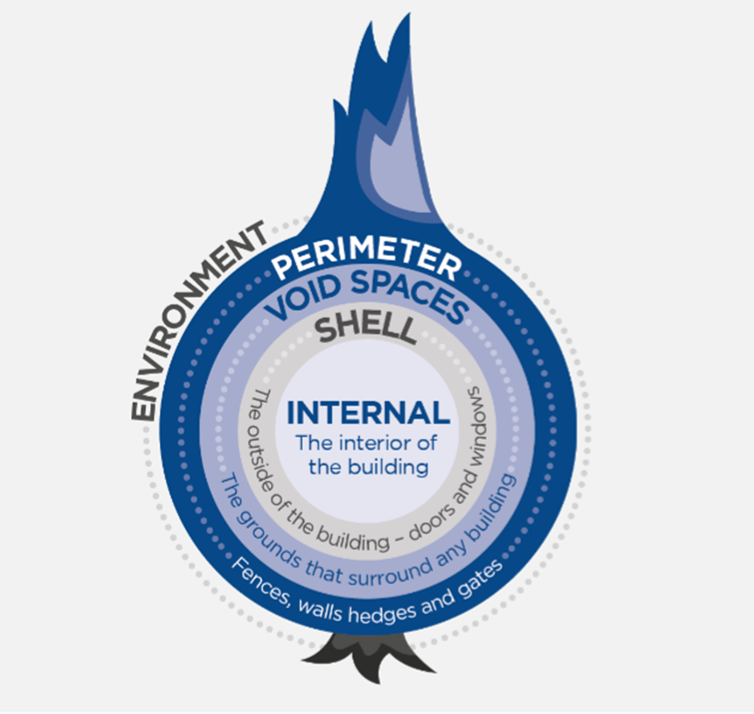
Basic Survey
“Security of a property is like peeling an onion…”
Notes:
Three stages:
Perimeter security – Garden and boundaries
Shell security – External features of the property e.g. doors and windows
Internal security – Inside of the property

Slide 3
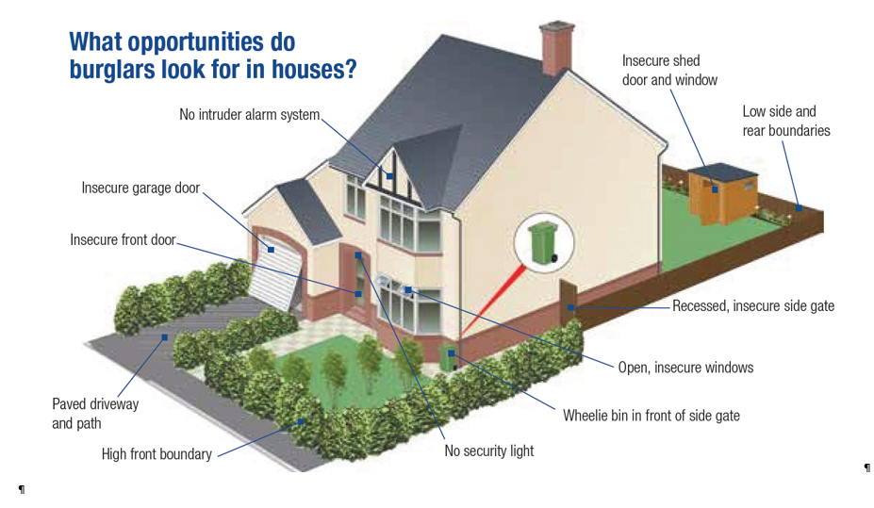
Dwelling Security
Notes:
You will have completed the Security products NCALT package so this should not be difficult. In your groups comment on good or bad for the associated number and why.

Slide 4
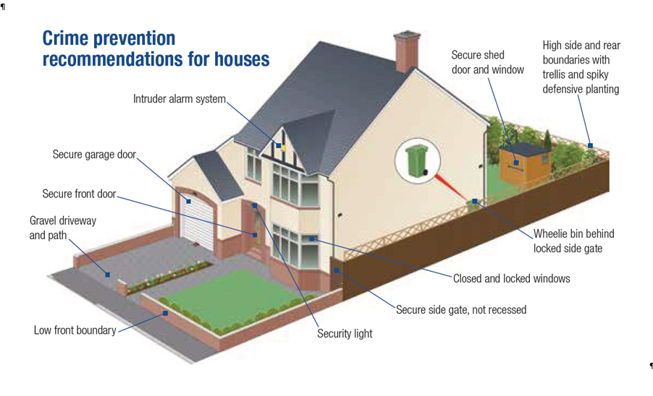
Dwelling Security

Slide 5
WINDOW SECURITY

Slide 6
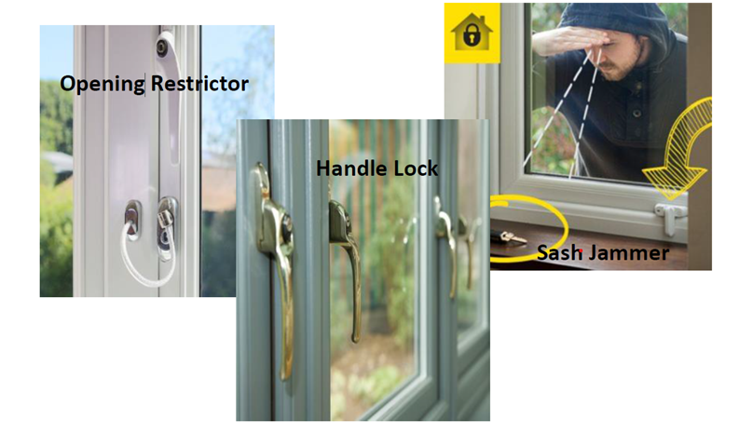
Window locks

Slide 7
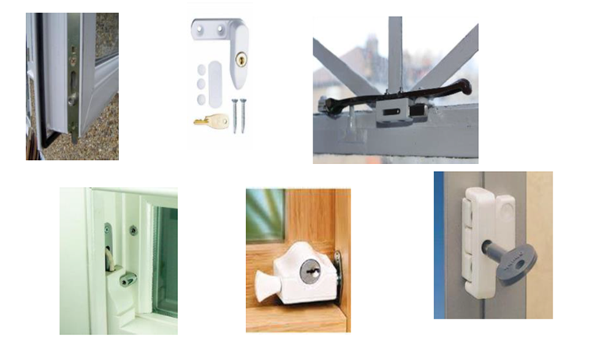
Window locks continued…

Slide 8
Recommended British Security Standards for Doors/Windows & Locks
BS Standard for all doors sets and windows to resist forced entry– PAS 24 2022
BS 3621 - Lock Standard by British Standards for thief resistant locks
LPS 1175 - Loss Prevention Standard for Security Shutters, Doors, Fencing and Key Safes

Slide 9
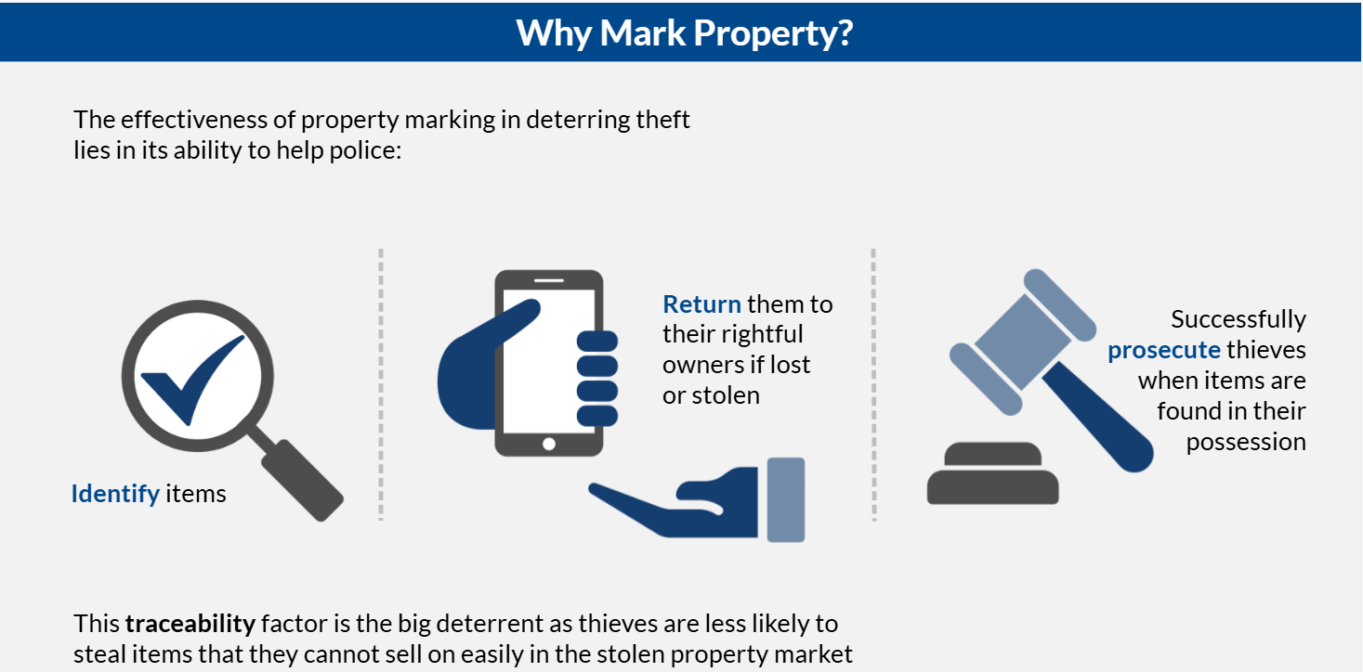
Property Marking

Slide 10
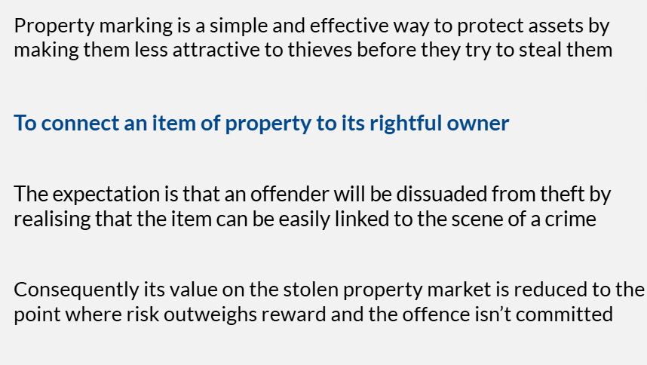

Property Marking
What is Property Marking?
What is Property Marking?
Different ways to mark personal items;
Forensic Marking Fluid
UV Marking Pens
Tamper proof labels
The expectation is that an offender will be dissuaded from theft by realising that the item can be easily linked to the scene of a crime
The expectation is that an offender will be dissuaded from theft by realising that the item can be easily linked to the scene of a crime
Property marking is a simple and effective way to protect assets by making them less attractive to thieves before they try to steal them
Property marking is a simple and effective way to protect assets by making them less attractive to thieves before they try to steal them
To connect an item of property to its rightful owner
To connect an item of property to its rightful owner
Consequently its value on the stolen property market is reduced to the point where risk outweighs reward and the offence isn’t committed
Consequently its value on the stolen property market is reduced to the point where risk outweighs reward and the offence isn’t committed

Slide 11

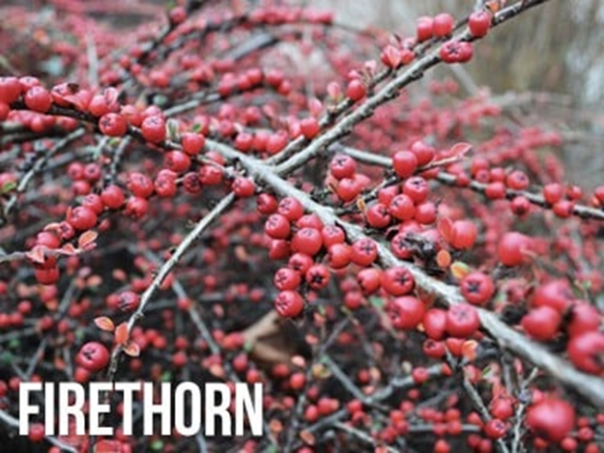
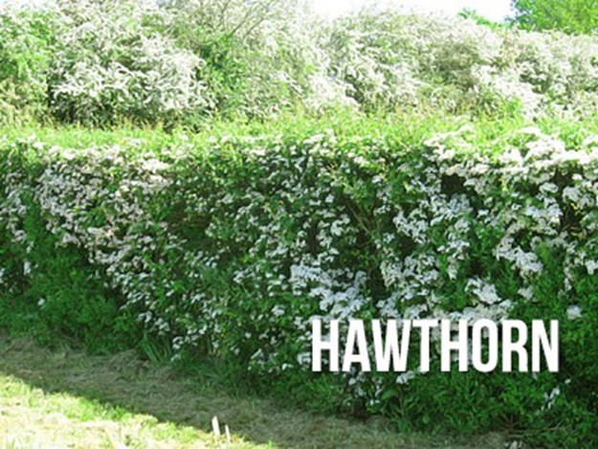
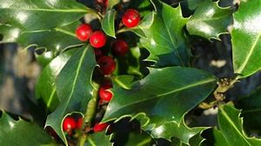

Defensive Planting
•Berberis – Considered as a deciduous and evergreen shrub, Berberis can grow from 1-5m.It has prickly spines on the shoots and on the leaves, making this shrub a great shield.
•Firethorn – Also known as Pyracantha, Firethorns are so spiky that thieves
would not dare go anywhere near them. This ornamental evergreen shrub
produce creamy white flowers in spring. Not only do they add beauty to your
outdoor space, they also provide you with protection and added security.
•Rosa Rugosa – With colours varying from white to dark pink, Rosa rugosa, also known as Japanese rose, can easily pass for a great outdoor defence. Its white and pink flowers bring an added glow to your outdoor space.
Hawthorn / Holly – Spiky and dense shrubs another form of great outdoor defence

Slide 12
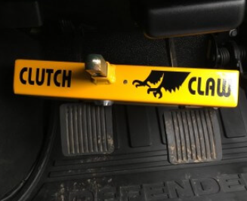
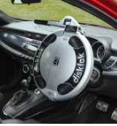
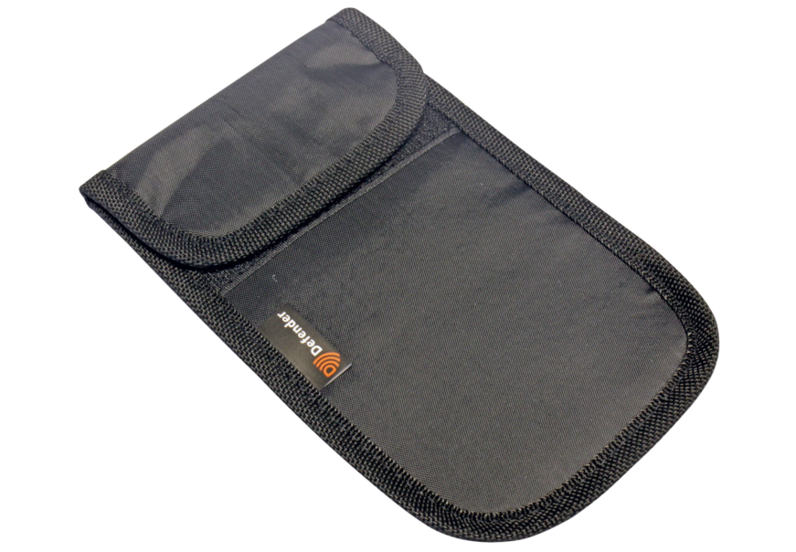
Keyless Car Theft
Sometimes vehicles are stolen after thieves jam the remote door locking frequency by using specialist jamming equipment. They then enter the vehicle and clone a key from the On-Board Diagnostic (OBD) port using specialist software. To help prevent this type of crime, consider fitting an ‘OBD safe’ device, a secure lockable device that fits over the vehicle’s on-board diagnostic port, in the vehicle cabin. This prevents criminals using software to code a key from the vehicle. We recommend devices that are ‘Thatcham’ approved, “Sold Secure, or “Secured By Design.

Slide 13
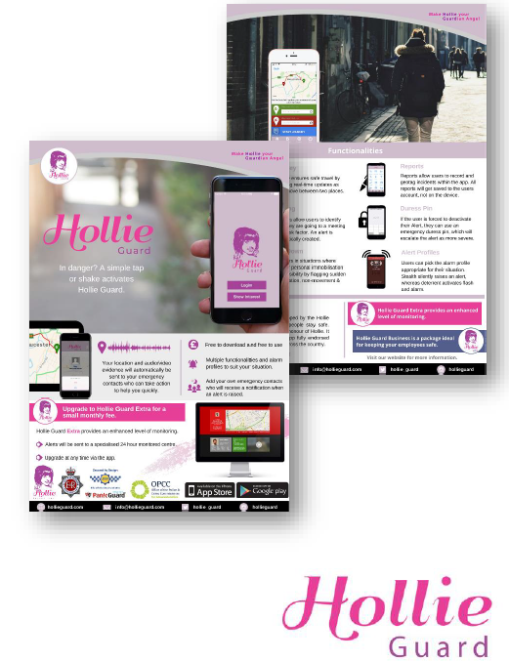
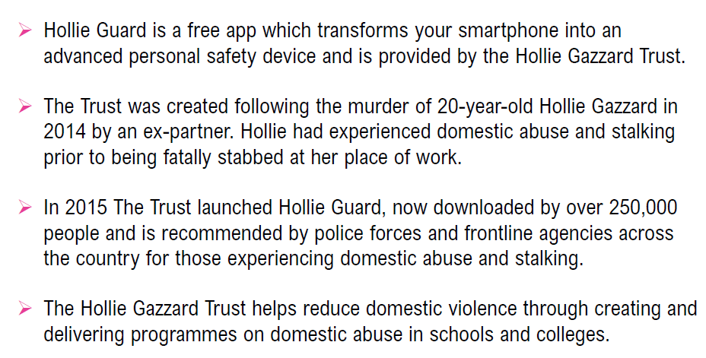


Hollie Guard Personal Safety App
App Features;
Journey Feature
Meeting Feature
Man Down
Report Feature – DA/Stalking/Harassment
Contact: - info@hollieguard.com

Slide 14
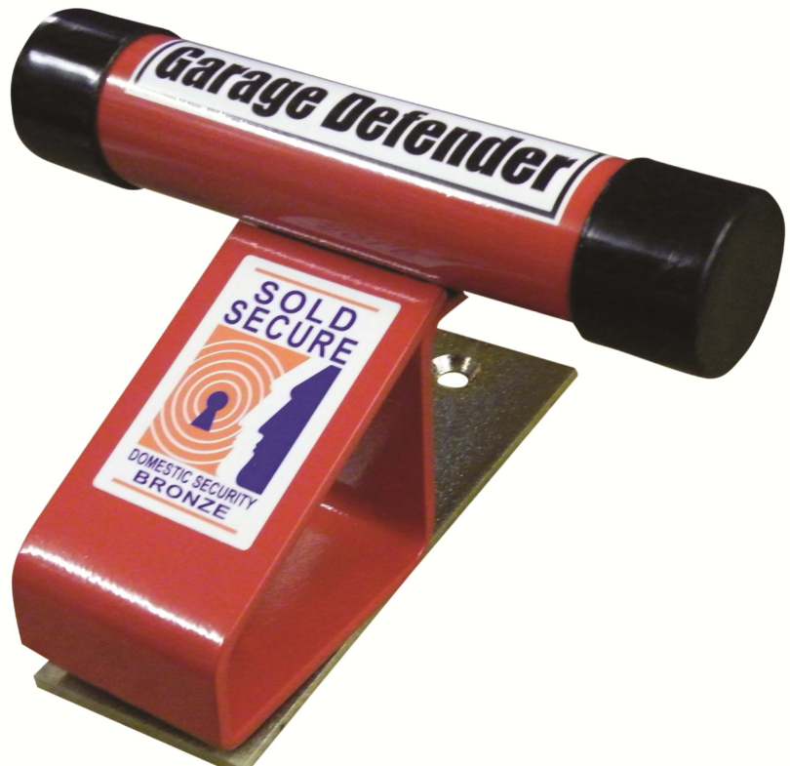
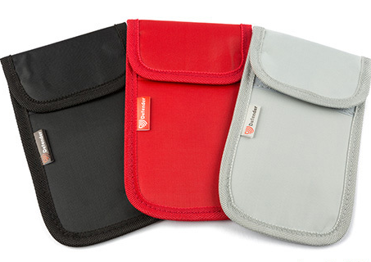
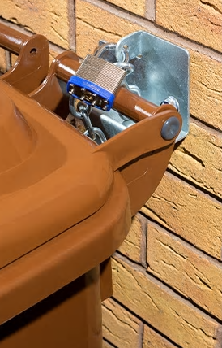
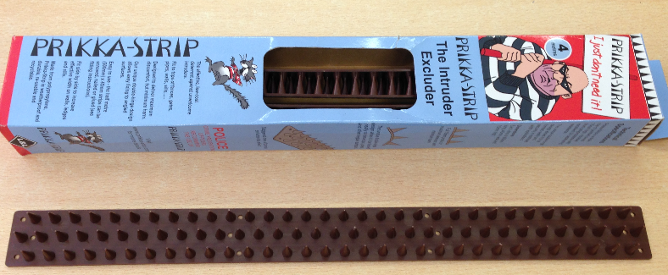

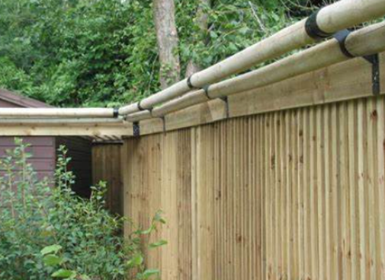
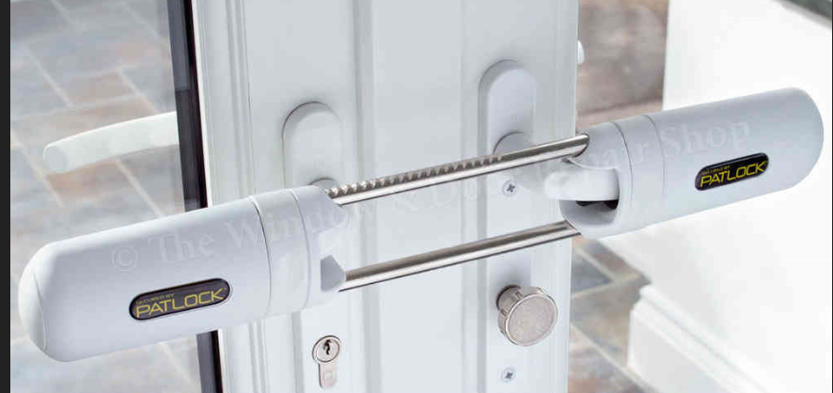
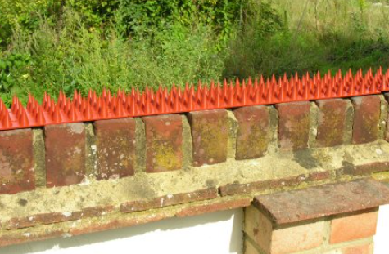
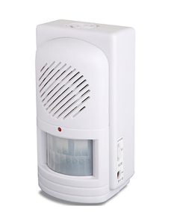
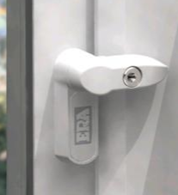

Security Products

Slide 15


Slide 16
Websites of interest
Solon Security – UK based company that sell variety of security products you can use to protect your home or yourself
Solon Security
Secure by Design - official police security initiative that works to improve the security of buildings and their immediate surroundings to provide safe places to live, work, shop and visit.
Secured by Design - Secured by Design
Master Lock Association – Accrediting body of lock smiths in the UK, provides a post code search engine for accredited locks smiths in your area
Master Locksmiths Association - Locksmith Near Me (Fully Vetted)
ICO – Information Commissioner Office-The Information Commissioner’s Office (ICO) upholds information rights in the public interest, promoting openness by public bodies and data privacy for individual
      Information Commissioner's Office

Slide 17
ANY QUESTIONS ?

